Slide 1



Basic Details of the Team and Problem Statement
Codictive 3.0 State-Level Hackathon
PS Code: PSC-ET-08
Problem Statement Title: AI-Based Adaptive Learning System – Implement an AI-driven platform that customizes learning content based on students' performance and engagement.
Team Name: AlgoWizards
Team Leader Name: Harshit Malviya
Institute Name: Lakshmi Narain College of Technology, Bhopal
Theme Name: EduTech

Slide 2
Team Member Details
Team Leader Name: Harshit Malviya
Branch: B.Tech. Stream: CSE Year: III
Team Member 1 Name: Deepanshi Mehra
Branch: B.Tech. Stream: CSE Year: III
Team Member 2 Name: Prerak Gupta
Branch: B.Tech. Stream: CSE Year: III
Team Member 3 Name: Rajnandini Tasre
Branch: B.Tech. Stream: CSE(DS) Year: III
Team Member 4 Name: Ravi Baraskar
Branch: B.Tech. Stream: CSE Year: III

Slide 3

Introducing: The Empathic Learning Companion
Revolutionizing education through personalized emotional AI, our Empathic Learning Companion adapts to individual student needs in real-time, fostering a more engaging and effective learning experience. By understanding and responding to students' emotional states, we aim to create a supportive and dynamic learning environment that promotes comprehension, retention, and a genuine love for learning.
By Team AlgoWizards

Slide 4

The Problem: One-Size-Fits-All Education
Failing Traditional Methods
Concerning Statistics
Traditional learning methods often fail to address the emotional state of students. When content is too difficult or uninteresting, students disengage, leading to frustration and decreased comprehension. A generic approach cannot cater to individual needs.
The national average course completion rate stands at a mere 58% (Source: National Student Clearinghouse Research Center). This highlights the urgent need for more personalized and emotionally intelligent educational solutions to boost course completion.

Slide 5





Our Solution: Real-Time Emotionally Adaptive Learning
Facial Emotion Detection
Identifies emotions such as confusion, boredom, and frustration in real-time through facial cues.
Voice Sentiment Analysis
Gauges a student's emotional state through speech patterns and sentiment analysis.
Adaptive Teaching Style
Dynamically adjusts the pace, content, and format of lessons based on emotional feedback.
Generative AI Integration
Creates personalized stories and quizzes from textbook content to enhance engagement.
Our pilot program demonstrated a remarkable 35% increase in student engagement, showcasing the effectiveness of our emotionally adaptive approach. By responding to students' emotional cues, we can create a supportive learning environment.

Slide 6
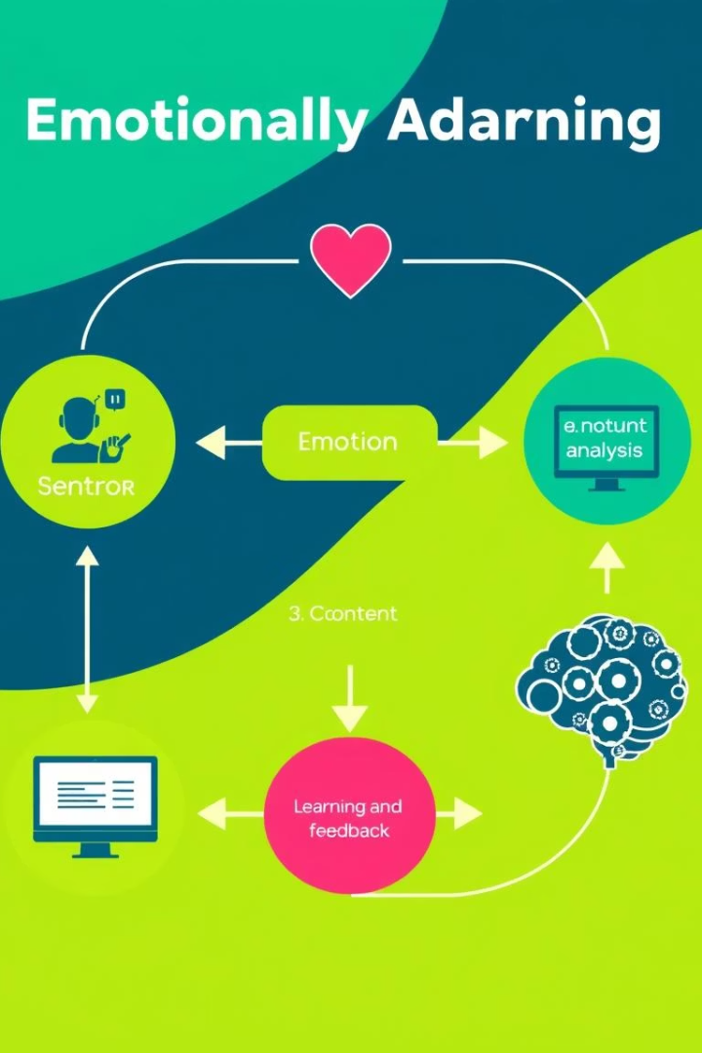




How It Works: A Multi-Modal Approach
Emotional Adaptability
Data Acquisition
Captures facial expressions and voice input using a webcam and microphone.
Emotion Analysis
AI algorithms analyze the collected data to identify emotional states.
Student
Content Adaptation
AI dynamically adjusts the content based on detected emotions.
Feedback Loop
Continuous monitoring and adaptation for personalized learning.
In beta testing, our approach resulted in a significant 28% reduction in student frustration rates, highlighting its ability to create a more positive and effective learning experience. This multi-modal approach creates a personalized experience.

Slide 7
Activity Diagram
Is student confused
Play lesson video
Check face & voice emotion
No
Still confused
Yes
Continue Normal
Generate story/quiz with the help of GPT
Ask if the student wants story/quiz
Yes
Reduce speed by 0.10x
No
Return to 1.0x speed

